Slide 1

UH TASI Data Science Professionals
Diabetes Readmission Analysis
Meynard Ballesteros
Haoyuan Zhang 02/16/2024

Slide 2

Introduction

Slide 3
Original Dataset
Health Facts Database (Cerner Corporation, Kansas City, MO)
Dataset was recorded from 1999 to 2008
Dataset has 41 Tables with a total of 117 Features
130 Hospitals throughout the United States.
74,036,643 Unique encounters
17,880,231 Unique patients
2,889,571 Providers
Notes:
The original database is from the Health Facts database (Cerner Corporation, Kansas City, MO), a national data warehouse that collect comprehensive clinical records across hospitals throughout the United States. The dataset collected represents 10 years (1999-2008) of clinical care at 130 hospitals throughout the United States. The database consists of 41 tables in a fact-dimension schema and a total of 117 features. The database includes 74,036,643 uniqure encounters that correspond to 17,880,231 unique patients and 2,889,571 providers.
This information is gathered from the paper. https://www.hindawi.com/journals/bmri/2014/781670/

Slide 4
Extracted Dataset
Original Database has various missing values and a vast amount features.
The dataset we are working with satisfies the following:
Inpatient Encounter
Diabetic Encounter
Length of Stay is at least 1 day and at most 14 days
Laboratory tests were performed
Medications were administered
101,766 Encounters and 55 Features.
Notes:
The original database contained incomplete, redundant, and noisy information. The extracted information from database for encounters satisfies only the following criteria, Inpatient encounter, diabetic encounter, length of stay was at least 1 day and at most 14 days, laboratory tests were performed during the encounter, medications were administered during the encounter. A total of 101,766 encounters were identified that fulfills the conditions. Clinical Experts extracted 55 features that were potentially associated with the diabetic condition.
This information is gathered from the paper. https://www.hindawi.com/journals/bmri/2014/781670/

Slide 5

Problem

Slide 6
Diabetes Readmission Prediction
Goal: To determine the early readmission of the patient within 30 days of discharge.
Why?
Many patients do not receive preventive and therapeutic interventions for glycemic control.
MONEY - Failure to provide proper diabetes care increases the costs for hospitals which will in turn impact the morbidity and mortality of patients.
Notes:
https://archive.ics.uci.edu/dataset/296/diabetes+130-us+hospitals+for+years+1999-2008

Slide 7

Descriptive and Diagnostic Analysis

Slide 8
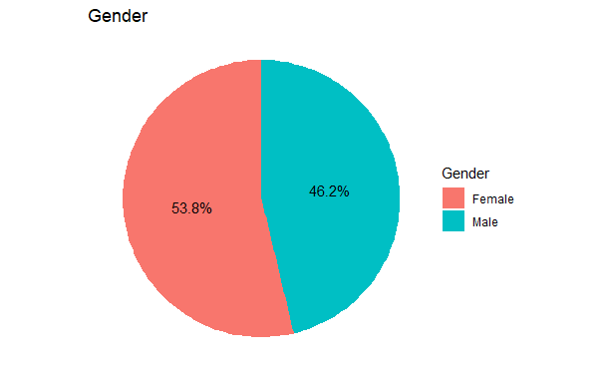
Gender
Notes:
Purpose: We wanted to see if gender would make any difference within the dataset.
What we got: It seems that there are more females than males but it is not significant enough to determine its importance.

Slide 9
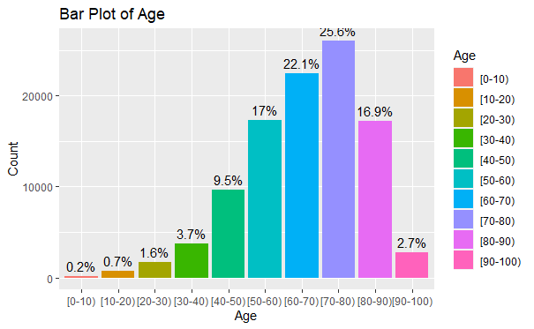
Age
Notes:
Purpose: Wanted to show the age range within the dataset
What we got: The dataset mainly contains patients that are the age of 50 to 90.

Slide 10
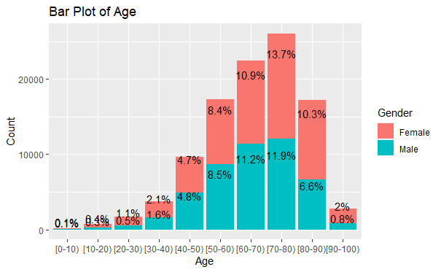
Gender and Age
Notes:
Purpose: Wanted to gather more information about gender in accordance to age.
What we got: Age is a very important feature in determining readmission and gender does not seem to have a correlation to diabetes.

Slide 11
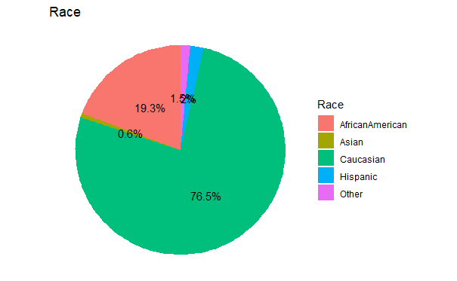
Race
Notes:
Purpose: We wanted to know the ethnic background of the dataset
What we got: We realized this dataset is in US, and notice a lot of Caucasians.

Slide 12
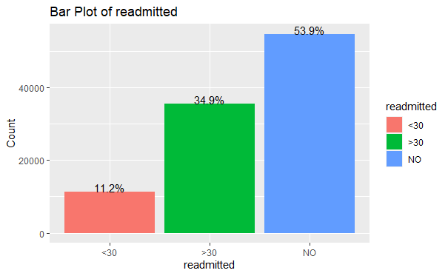
Readmitted

Slide 13
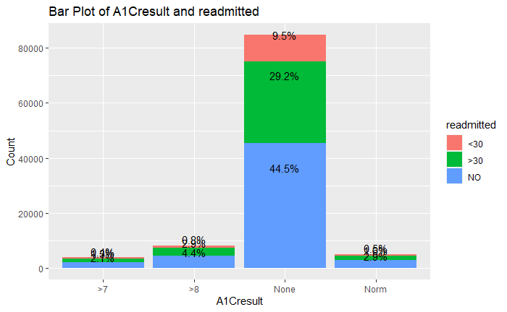
Readmitted and A1Cresult

Slide 14
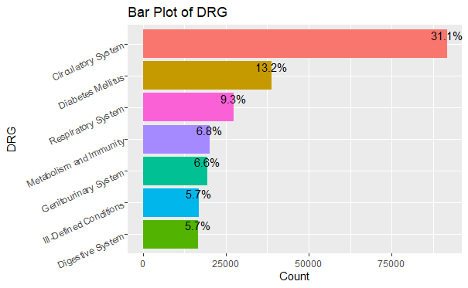
DRG (Diagnosis Related Group)

Slide 15
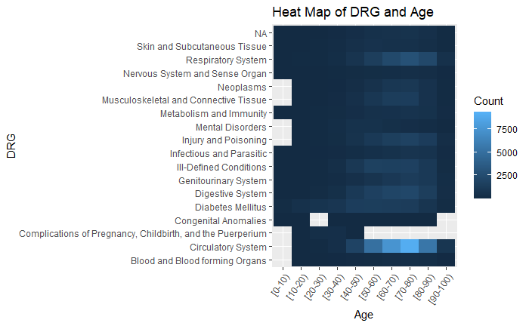
DRG and Age

Slide 16
Predictive and Prescriptive Analysis

Slide 17
Logistic Regression
Response Variable
>30
1
Readmitted
<30
None
0

Slide 18
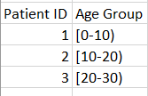
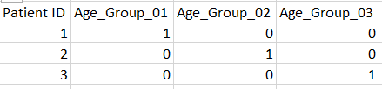
Logistic Regression
Explanatory Variables
Categorical variables
Dummy variables
Age Groups Diagnosis Codes Race Gender …

Slide 19
Logistic Regression
Dummy Variable Trap - The Dummy Variable Trap occurs when two or more dummy variables created by one-hot encoding are highly correlated (multi-collinear) E.g.
Gender: Male, Female -> 1 Dummy Variable w/ an intercept OR 2 Dummy Variables w/o an intercept
Age: 10 Age Groups -> 9 Dummy Variables w/ an intercept OR 10 Dummy Variables w/o an intercept

Slide 20
Logistic Regression
Response Variable
Explanatory Variables
Race
Gender
~
Lab Tests
Readmitted
Age Groups
Time in hospital
The Number of Diagnoses
Diabetes Medication
Diagnosis Code Groups
Outpatient/Inpatient/Emergency Visits

Slide 21
Logistic Regression
Impact of Coefficient Sign:
If the coefficient is positive, an increase in the explanatory variable is associated with an increase in the odds of the response.
If the coefficient is negative, an increase in the explanatory variable is associated with a decrease in the odds of the response.

Slide 22
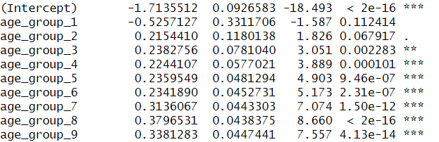
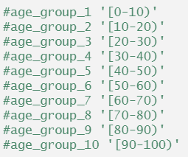
Logistic Regression
Notes:
Older individuals often have more complex health needs, multiple chronic conditions, and may experience more severe illnesses, leading to a higher likelihood of hospital readmission.

Slide 23
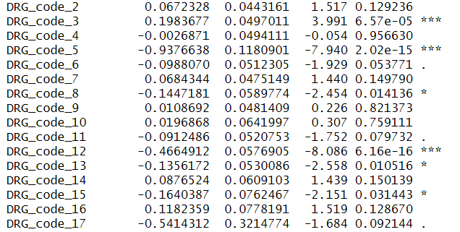
Logistic Regression

Slide 24
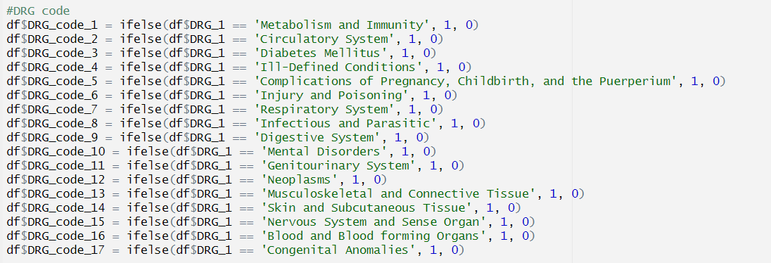
Logistic Regression
Notes:
Diabetes Mellitus is a chronic condition that requires ongoing management. Patients with diabetes may experience complications or require additional care, contributing to a higher likelihood of hospital readmission.

Slide 25
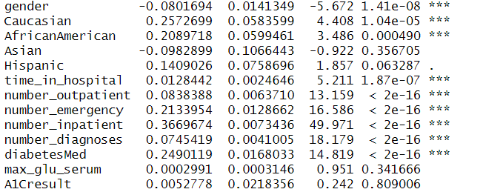
Logistic Regression
Notes:
Longer hospital stays may indicate more severe illnesses or complications, which can increase the risk of readmission. A higher number of diagnoses may signify a more comprehensive medical history with multiple health issues, contributing to increased readmission risk. More lab tests may indicate a need for extensive monitoring or investigation, suggesting a higher severity of illness, which can contribute to increased readmission risk. Frequent outpatient/inpatient visits may indicate ongoing health issues that require continuous management, contributing to an increased likelihood of readmission. Higher emergency visits may reflect acute health events, indicating a higher risk of subsequent readmission. The prescription of diabetic medication may indicate active management of diabetes, but it could also suggest more complex healthcare needs, increasing the likelihood of readmission.

Slide 26
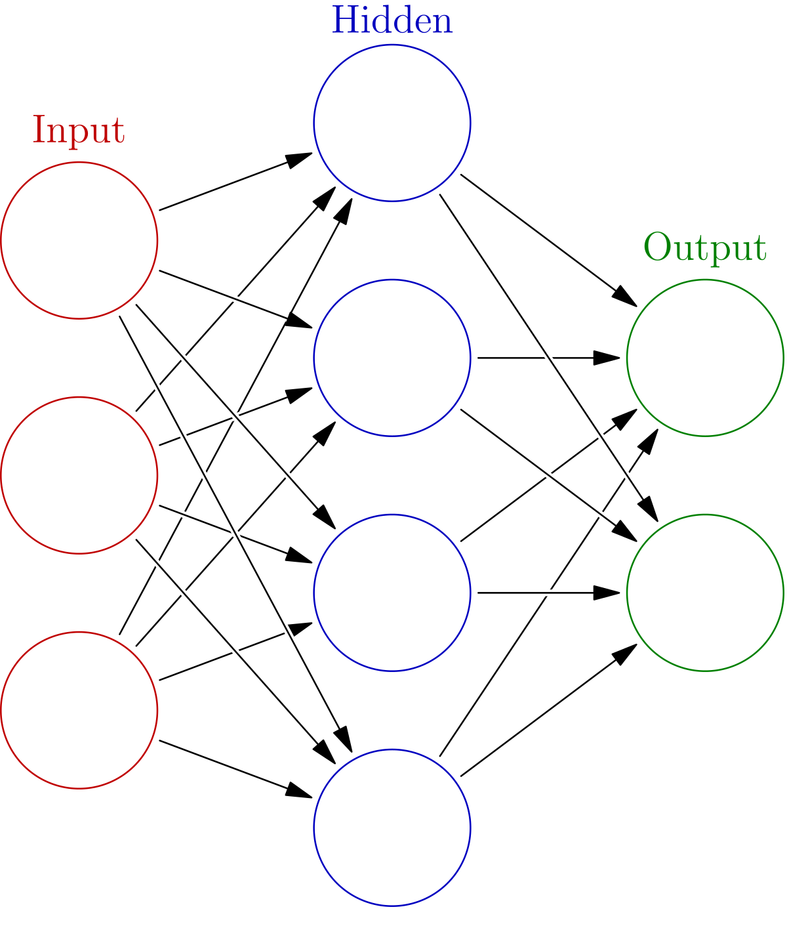
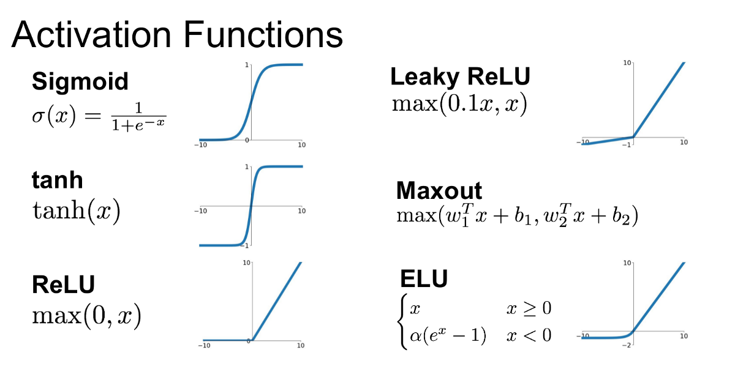
Neural Network
Bias
Notes:
Input layer, essay enough to explain
Hidden layer: Its where it processes the input layer and bias. Bias nodes are added to increase the flexibility of the model to fit the data. It multiplies the weights of each input and adds the bias which is then passed on into an activation function.
Activation function: They introduce non-linear properties to the network, allowing it to learn more complex patterns. There are various activation functions such as the rectified linear unit (ReLU) function, and the family of sigmoid functions such as the logistic sigmoid function, the hyperbolic tangent, and the arctangent function. The activation function that we are using is the logistic sigmoid function.
Then we have the output layer.

Slide 27
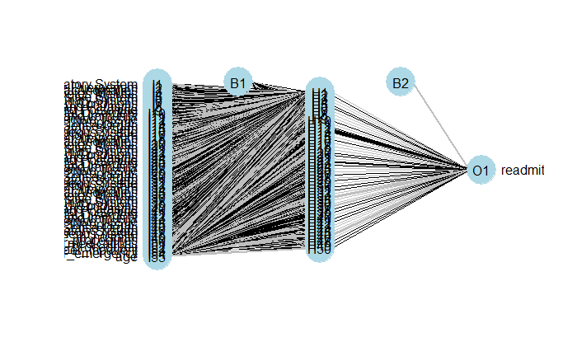
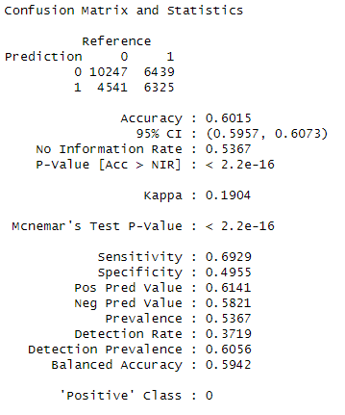
Neural Network
Formula( readmitted ~ DRG_1+DRG_2+DRG_3+time_in_hospital+num_procedures+num_medications+num_lab_procedures+number_inpatient+number_emergency+age)

Slide 28
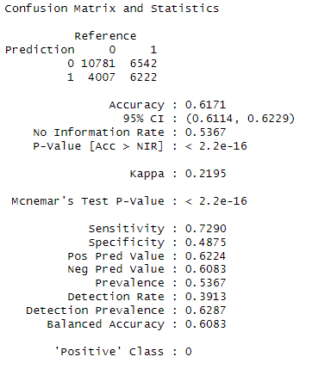
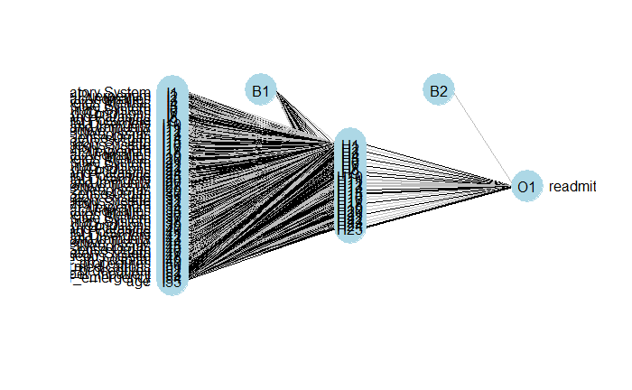
Neural Network
Formula( readmitted ~ DRG_1+DRG_2+DRG_3+time_in_hospital+num_procedures+num_medications+num_lab_procedures+number_inpatient+number_emergency+age)

Slide 29
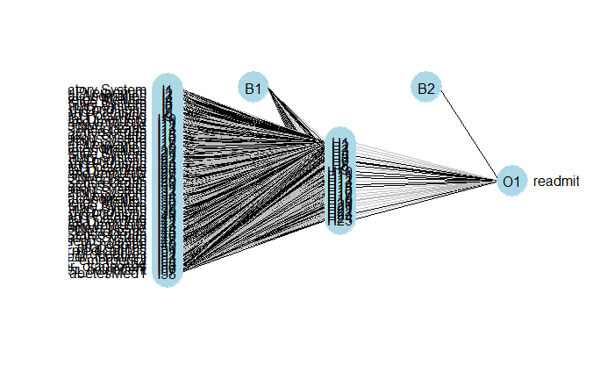
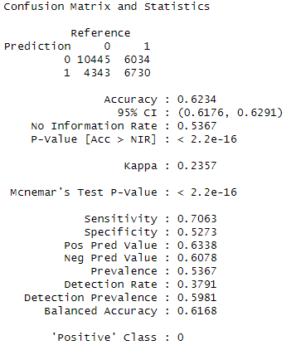
Neural Network
Formula( readmitted ~ DRG_1+DRG_2+DRG_3+time_in_hospital+num_procedures+num_medications+num_lab_procedures+number_inpatient+number_emergency+age+number_diagnoses+number_outpatient+diabetesMed)

Slide 30
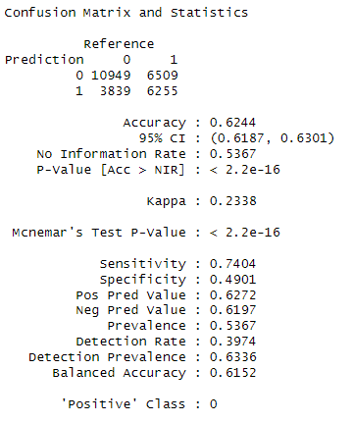
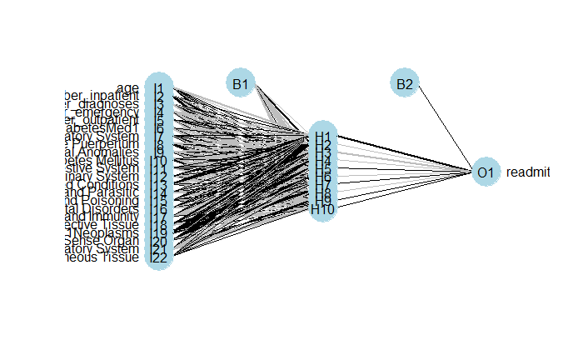
Neural Network
Formula( readmitted ~ age+number_inpatient+number_diagnoses+number_emergency+number_outpatient+diabetesMed+DRG_1)

Slide 31

Conclusion Summary

Slide 32
Data Science Competition Conclusive Summary
What is the most common primary diagnosis by age group?
Based on the Heat Map on Slide 14, It is found that Circulatory is the most common within the age group 40-90.
Some doctors believe diabetes might play a central role in readmission. Explore the effect of a diabetes diagnosis on readmission rates.
Primary Diagnosis: Diabetes Mellitus; Diabetic Medication Prescribed
Age
The count of lab tests
Number of Diagnoses Entered into the System
Number of Days in hospital
Outpatient/inpatient/emergency visits

Slide 33
Data Science Competition Conclusive Summary
On what groups of patients should the hospital focus their follow-up efforts to better monitor patients with a high probability of readmission
Multiple inpatient/outpatient/emergency visits
A higher number of diagnoses
Diabetic medication
More lab tests
Older individuals

Slide 34
THANK YOU!
Any Questions?
Github: https://github.com/Xerconia/DataScience-Diabetes
Meynard: https://github.com/Xerconia
Haoyuan: https://github.com/Travis-ZhangMYG
Organization: https://github.com/UH-TASI

